Slide 1
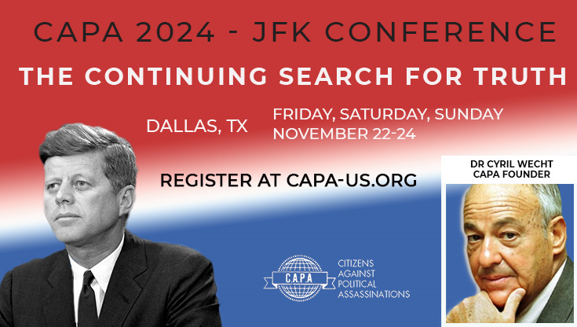
A Tribute to Cyril Wecht -- David W. Mantik and Gary Aguilar
The opening music is from the movie JFK.* The violinist will play The Funeral March by Chopin—which recalls JFK’s casket procession to his gravesite.
* jfk suite – YouTube by John Williams

Slide 2
A Tribute to Cyril Wecht, MD, JD
In Chicago during April 1-4, 1993, the Second Annual Midwest Symposium on Assassination Politics featured one of the most impressive groups of experts ever assembled. It was my first conference. Here I met Cyril for the first time and watched his impassioned 20-minute speech on the Single Bullet Theory.
Dr. Cyril Wecht’s impassioned speech at the 1993 Chicago JFK assassination conference remastered (youtube.com)

Slide 3
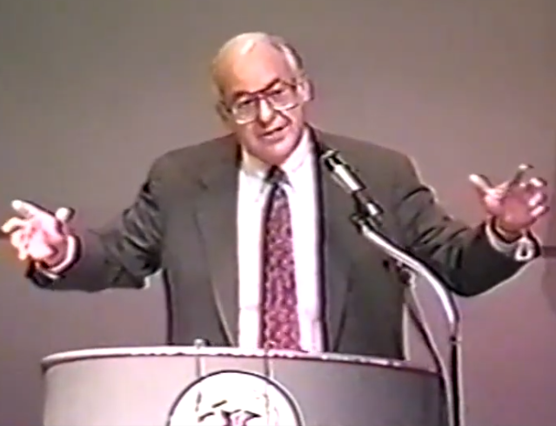
Little did I know that 30 years later I would introduce this same (recorded) speech at a dinner honoring Cyril during his final conference (2023).

Slide 4
Randy Benson:
Also, as you know, Cyril was one of the central researchers profiled in my 2017 film, The Searchers. I'm making the film available FREE of charge for viewing for the rest of the year. I'd appreciate it if you could help get the word out. Link: https://vimeo.com/223029621
In addition, I've made the uncut raw interview with Cyril available FREE of charge. This was perhaps the highlight of my career. Again, if you could help get the word out about this, I'd appreciate it very much. Link: https://vimeo.com/946265089

Slide 5
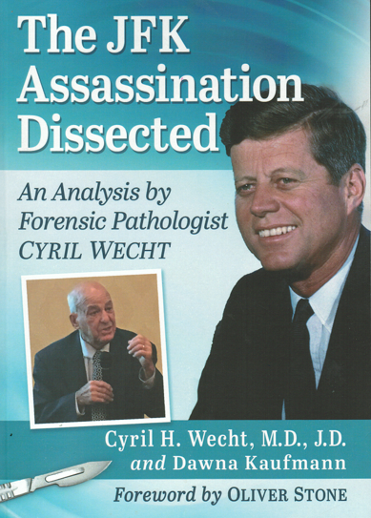
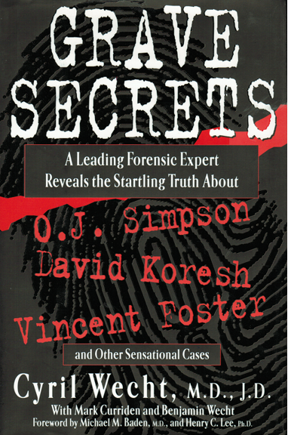
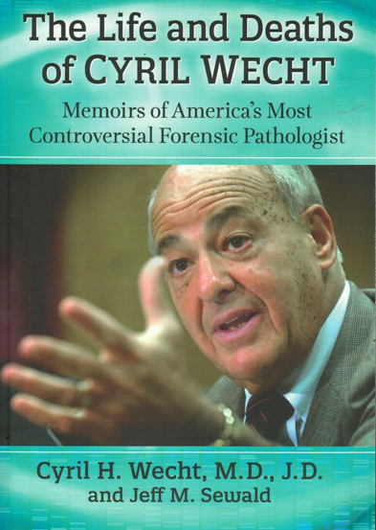
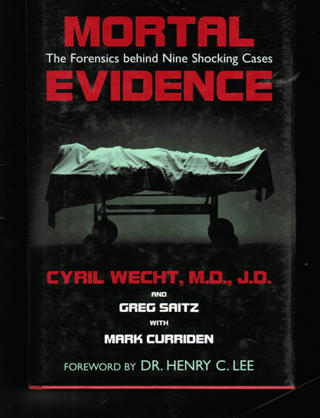
Wecht: on Death

Slide 6
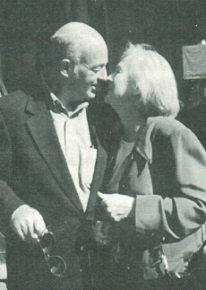

Slide 7
      Survivors
Wife: Sigrid Ronsdal Wecht, a family practice attorney
Four children:
--David, a Pennsylvania Supreme Court Justice
--Daniel, a clinical professor in the Neurosurgery Department at UPMC
--Benjamin, an educator and writer
--Ingrid, a physician specializing in gynecology
And 11 grandchildren.

Slide 8
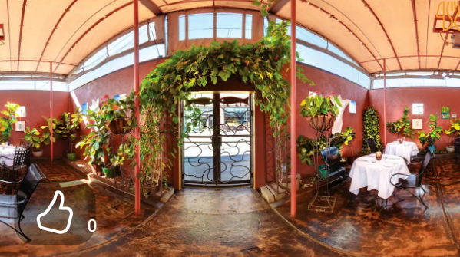
Casbah

Slide 9
Often a President…
The American Academy of Forensic Sciences
The American College of Legal Medicine
The Board of Trustees of the American Board of Legal Medicine

Slide 10
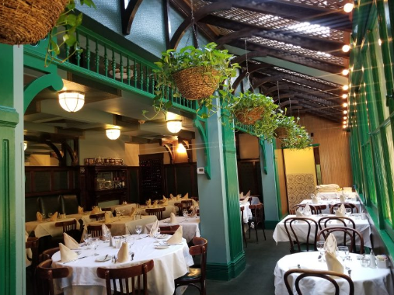

6 Things Not to Miss on Spain’s Magical Island of Mallorca

Slide 11
A Quote from Dr. Wecht: on the Price of Speaking Truth to Power
“It was around this time that I began seeing doors once opened to me as a nationally recognized forensic pathologist beginning to close. Several invitations to participate as a faculty member in seminars at the AFIP were no longer offered to me. There is no doubt that if I had kept my mouth shut and toed the government line in the Kennedy case, I would have been appointed….I also have gotten the cold shoulder from several national pathology organizations….”

Slide 12
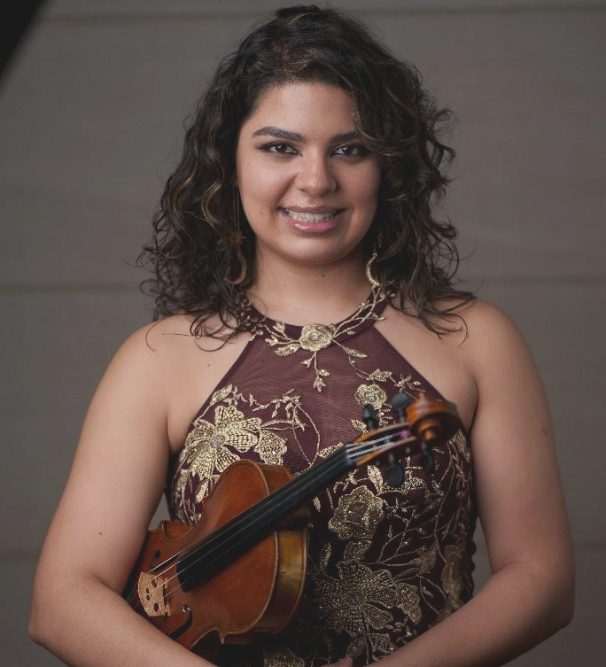
Violinist:
Yasmine Bougacha
Yasmine Bougacha is an exceptional soloist and chamber musician known for her nuanced and diverse stylistic performances. With a rich heritage rooted in Mexican and Tunisian cultures, Yasmine has performed across three continents, including a notable debut as concertmaster and soloist at Carnegie Hall. Her dynamic career is highlighted by engagements such as performing with the Texas female mariachi group Rosas Divinas, Grammy winners at the Stowe Tango Music Festival and Wynton Marsalis and the Jazz at Lincoln Center Orchestra at the Brevard Music Divines Center. Yasmine’s passion for a broad range of musical genres has also led her to arrange traditional Arabic songs, reflecting her deep connection to her cultural roots. She holds a Master of Music and an Artist Diploma in Violin Performance from the University of Cincinnati College-Conservatory of Music, where she studied under Won-Bin Yim and Timothy Lees.

Slide 13

Obituaries
A standout student, violinist and athlete at Fifth Avenue High School, he graduated as Class Valedictorian and went on to the University of Pittsburgh, where he distinguished himself as President of Phi Epsilon Pi fraternity, Concertmaster of the Pitt Symphony, Business Manager of the Pitt News, and [Jewish!] President of the YMCA, among many other honors. After earning his medical degree at the University of Pittsburgh Medical School, Cyril was called into his country's service, and proudly served as a Captain in the United States Air Force. It was there that he met his wife Sigrid, herself an immigrant, who also was serving in the United States Air Force.
CYRIL H. WECHT, M.D., J.D. | Obituary | Pittsburgh Post Gazette

Slide 14
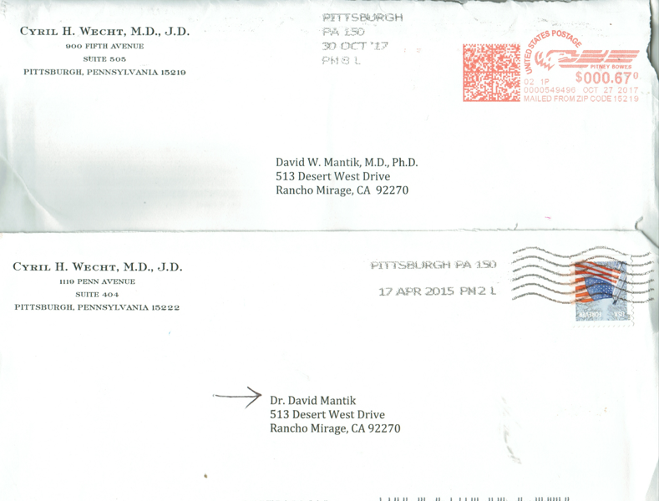
Cyril H. Wecht, An Avid Correspondent

Slide 15
“Cyril couldn’t be intimidated if you faced him with a Sherman tank.”―F. Lee Bailey
“I respect Cyril enormously because he stays out there in the public eye and keeps saying what he believes. He’s a straight shooter.”―Oliver Stone
“Cyril Wecht is an old warrior. When I had dinner with him not too long ago, I could still see bright flashes of the curiosity, the indignation and the fire that have propelled his legendary career for five decades.”―Alec Baldwin
“Cyril is a no-nonsense, straight-talking expert. He’s a renowned scientist who has little patience for rigmarole or politics. He speaks to the forensic truth of what his investigations and examinations reveal.”―Geraldo Rivera
“Cyril Wecht has tremendous credibility. He is not a ‘witness for hire.’ He’s a witness for truth.”―Alan Dershowitz.

Slide 16
Our Ancestors
Cyril’s father, Nathan Wecht, was a Lithuanian-born storekeeper; his mother, Fannie Rubenstein was born in Ukraine (like Tevya, the dairyman).
My grandmother, Emilie Dobberstein, was born in Ukraine. Like Tevya, I was raised on a dairy farm.

Slide 17
Cyril H. Wecht, MD, JD
Casey J. Quinlan -- President of Project JFK/CSI Dallas 10/09/2024:
David, as you know, I was a high school teacher for over 45 years. I rewrote the curriculum for social studies so I could implement the TRUTH in American History concerning the JFK Assassination. Dr. Cyril Wecht was a cornerstone for the continued research AND THE ADVANCEMENT OF TRUTH IN OUR AMERICAN JOURNEY.
He was the INSPIRATION, the PERSPIRATION and EXPLORATION for all of us who believe in AMERICA. He paved the path that we have traveled for the past 61 years and continue to travel today. He served the UNITED STATES very well and will be an INSPIRATION for TRUTH, JUSTICE & THE AMERICAN WAY OF LIFE.

Slide 18
Randy Benson:
I once thought my father was the hardest working, most honorable man I've ever known. No one could possibly measure up to him. When I met Dr. Cyril Wecht, I realized that my father had a distinguished rival. I first met Cyril in 2007 as I was collecting interviews for my film, The Searchers. He and his son, Ben, welcomed me and my cameraman to Cyril's office in downtown Pittsburgh. My first impression was that he was the hardest worker I've ever seen. He graciously offered me as much time as I needed to complete the interview.
Afterwards, I asked him if I could treat him and Ben to lunch. He replied that he would love to however he had to be in court in fifteen minutes! A giving, gracious, humble and kind gentleman. I was honored to then be asked by Cyril to join the board of the Coalition Against Political Assassinations, on which I served from 2018-2020. Another high point of my professional life. One of the regrets of my life is that my children never had the pleasure of meeting Cyril, however his story will be preserved by all of us who were lucky enough to be graced by his life.

Slide 19
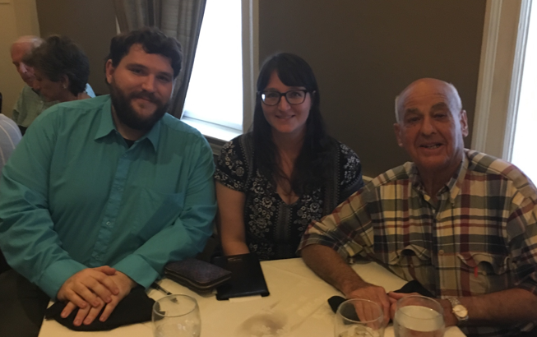
Meredith and Chris Mantik—with Dr. Wecht

Slide 20
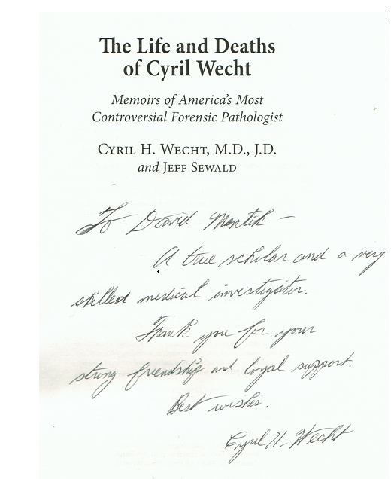
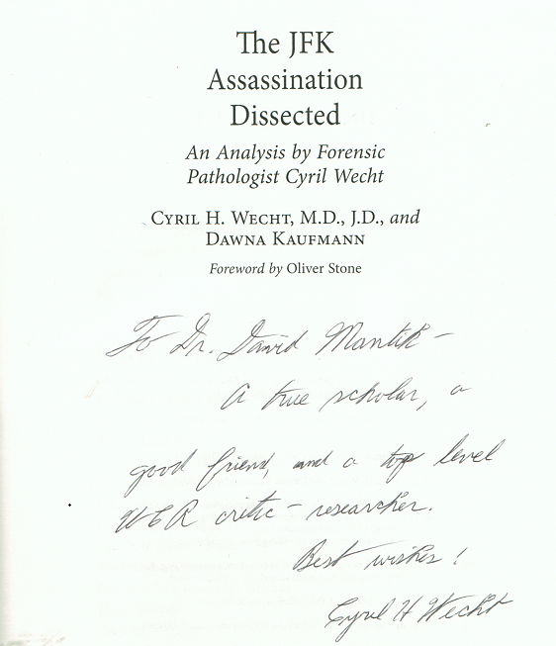

Slide 21
Wecht Publications
From Crime Scene to Courtroom (2011)
Investigation of Police Related Deaths (2011)
Forensic Science and Law (2006)
Tales from the Morgue (2005)
Forensic Aspects of Chemical and Biological Terrorism (2004)
Mortal Evidence (2003)
Into EVIDENCE: Truth, Lies and Unresolved Mysteries in the Murder of JFK
November 22, 1963: A Reference Guide to the JFK Assassination
Grave Secrets: A Leading Forensic Expert Reveals the Startling Truth about O.J. Simpson, David Koresh, Vincent Foster, and Other Sensational Cases
Who Killed JonBenet Ramsey?
A Question of Murder
Cause of Death (1993)
Legal Medicine (1985)
Exploring the Medical Malpractice Dilemma (1972)
Preparing and Winning Medical Negligence Cases (2016)
Forensic Pathology in Civil & Criminal Cases (2016)
The Life and Deaths of Cyril Wecht: Memoirs of America's Most Controversial Forensic Pathologist (2020)^{[40][35]}
The JFK Assassination Dissected: An Analysis by Forensic Pathologist Cyril Wecht (2021)^{[41]}
Final Exams: True Crime Cases from Forensic Pathologist Cyril Wecht ^{[42]}(2021)

Slide 22
Governor Josh Shapiro comments
After his passing, many people prayed for his family, including Pennsylvania Gov. Josh Shapiro, who said,
“Today, Lori and I are praying for his wife Sigrid, their four children, and the entire Wecht family.

Slide 23
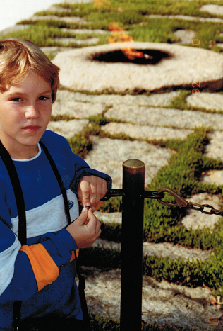
Arlington National Cemetery-
The Eternal Flame

Slide 24
Dr. David R. Wrone
(for November 22, 2024)
Two score and eighteen years ago, in the autumn of 1966, Dr. Cyril Wecht published his first major article depicting the medical irregularities of the fraudulent investigation into President John F. Kennedy’s assassination. As a rock that no hammer could break for the next 58 years, he maintained his critical scholarly dissent.
NOTE: Dr. Wrone suggested playing The Funeral March.

Slide 25
Dr. Cyril Wecht’s impassioned speech at the 1993 Chicago JFK assassination conference remastered
Randy Benson Link: https://vimeo.com/223029621

Slide 26
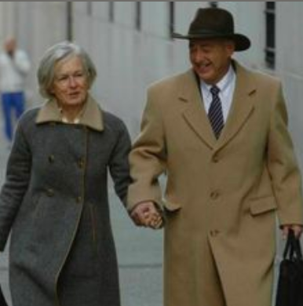
We shall never forget you…

